Slide 1




SIMPLYFLY
AIR TICKET BOOKING
NAME : Swetha B
TRAINER NAME : Javeed Mohammed Husnuddin

Slide 2
TOOLS & TECHNOLOGIES USED
FRONTEND (ReactJS 19):
React.js, Bootstrap for responsive UI, JavaScript for validation and interactivity.
BACKEND (Spring Boot):
RESTful APIs with ORM (Hibernate), Postman & API versioning.
AUTHENTICATION:
JSON Web Tokens (JWT) for secure authentication, Role-based access.
DATABASE:
MySQL with ORM integration for CRUD operations.
TESTING:
Postman for API testing , Junit for unit tests.

Slide 3
PROJECT DESCRIPTION
SimplyFly is a web-based air ticket booking application that enables users to register, log in securely, search for flights, view schedules, select seats, book tickets, make payments, and manage bookings.
The system also provides a Flight Owner Dashboard to manage flight routes, schedules, fares, and bookings, and an Admin Dashboard for managing users, routes, and overall system operations.
Security is enforced through JWT-based authentication and role-based access control.
The project is developed using React.js (frontend), Spring Boot (backend), MySQL (database), with REST APIs, ORM, Postman, logging, and unit testing to ensure reliability, scalability, and secure user experience.

Slide 4
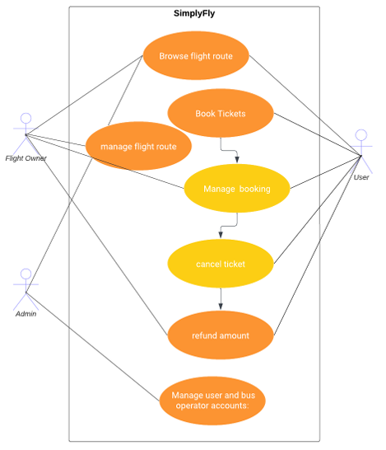
USECASE DIAGRAM

Slide 5
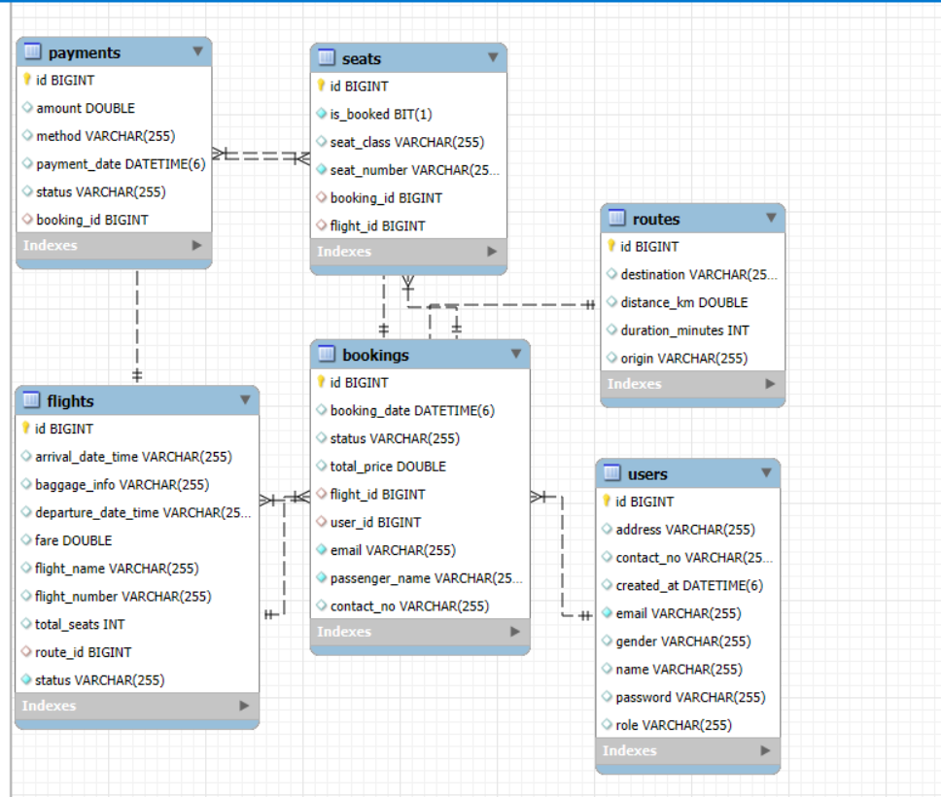
EER DIAGRAM

Slide 6
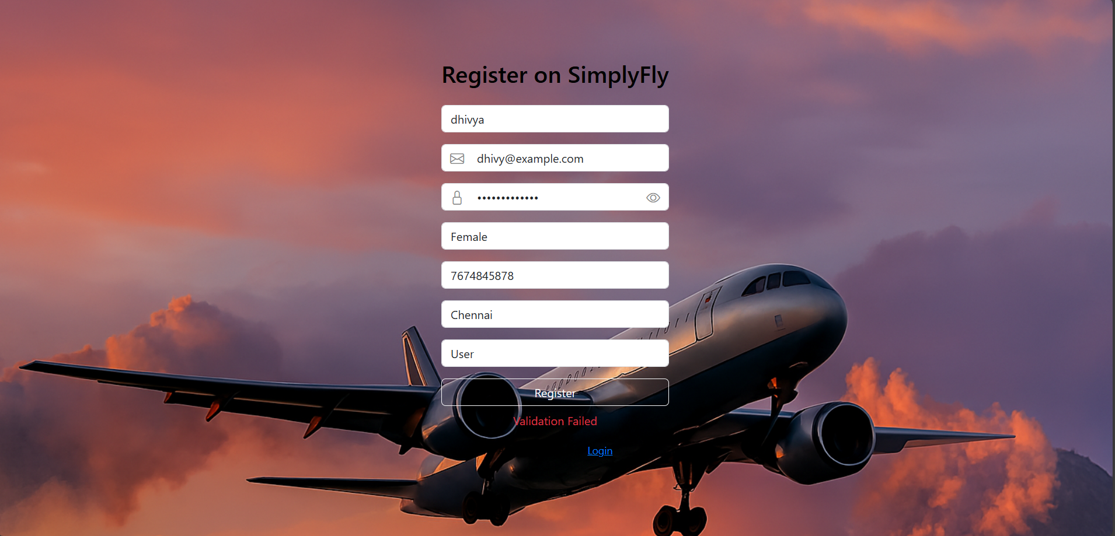
REGISTER PAGE

Slide 7
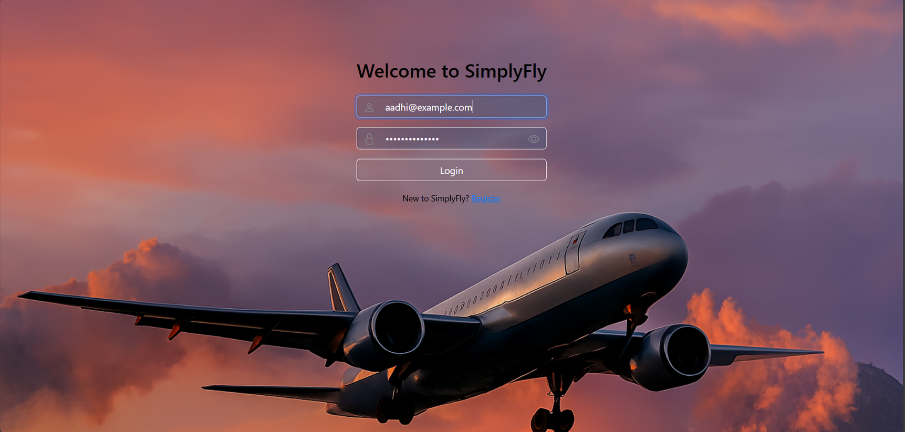
SCREENSHOTS
LOGIN PAGE

Slide 8
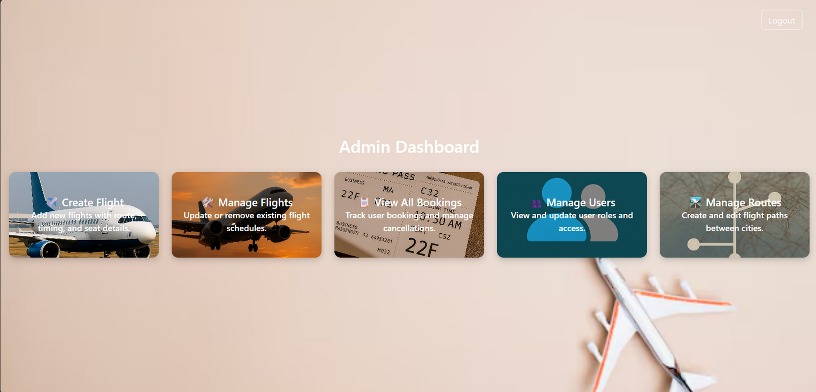
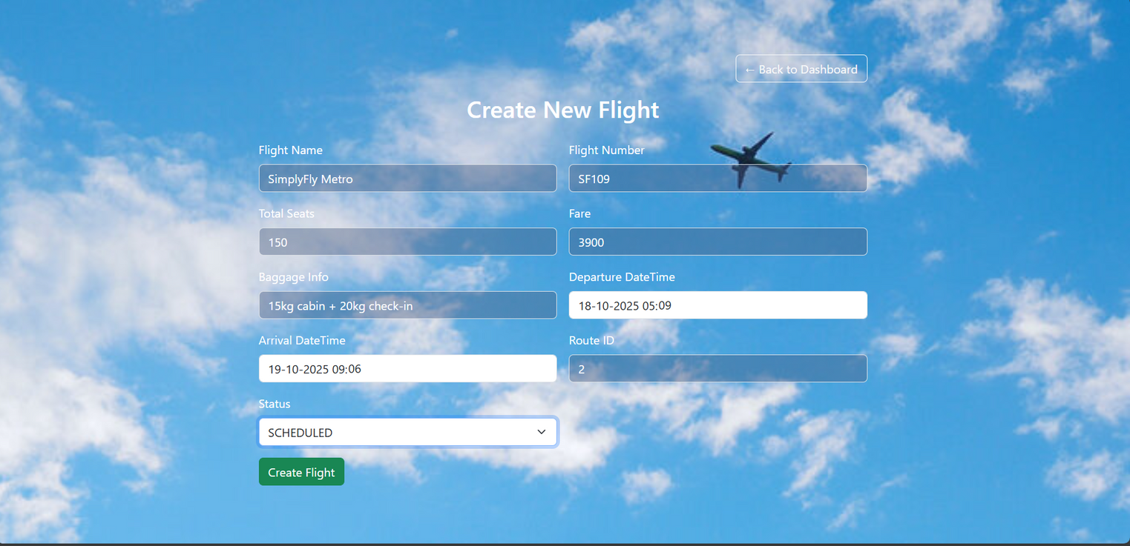
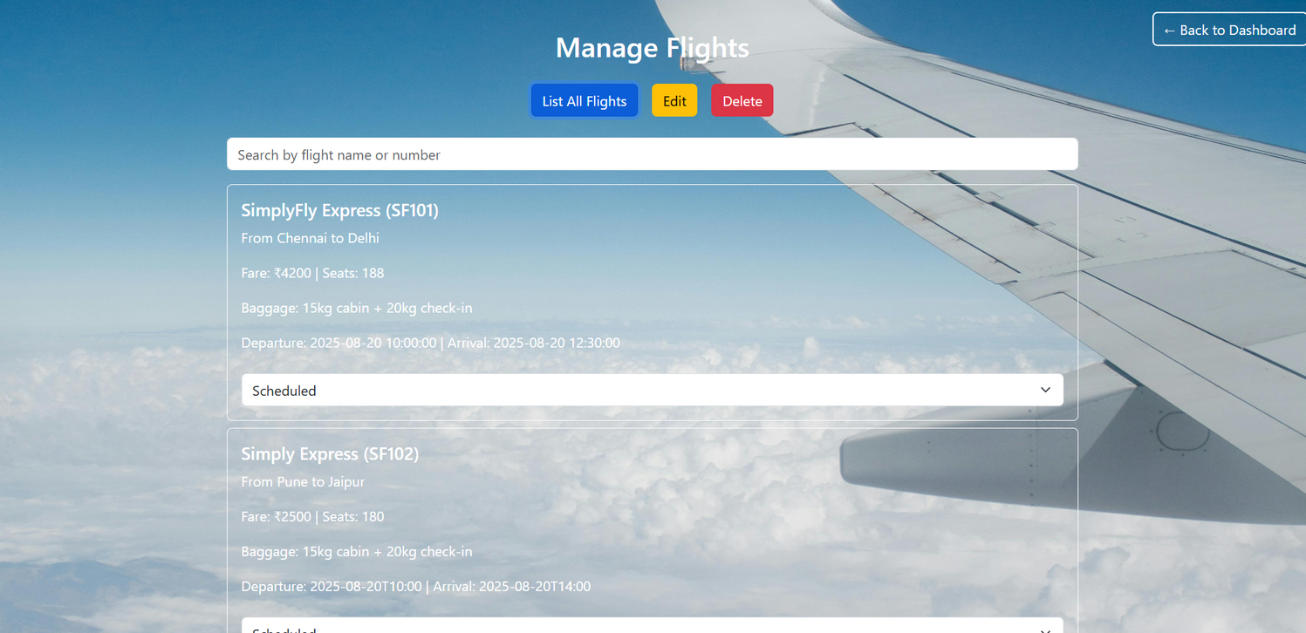
SCREENSHOTS
ADMIN DASHBOARD

Slide 9
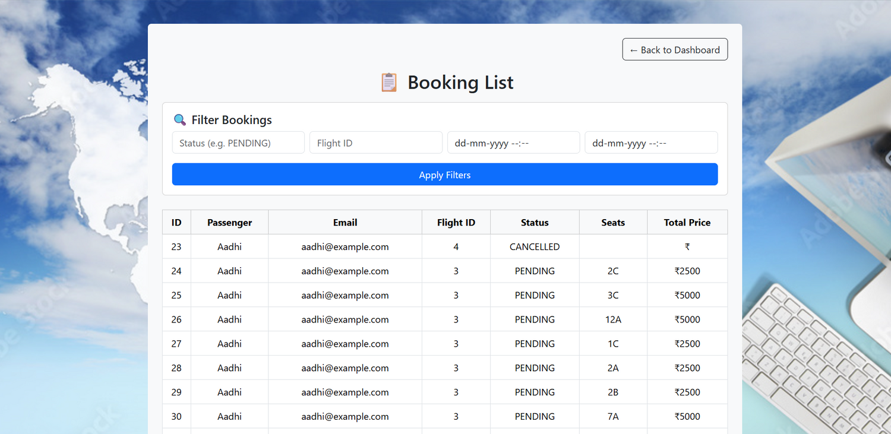
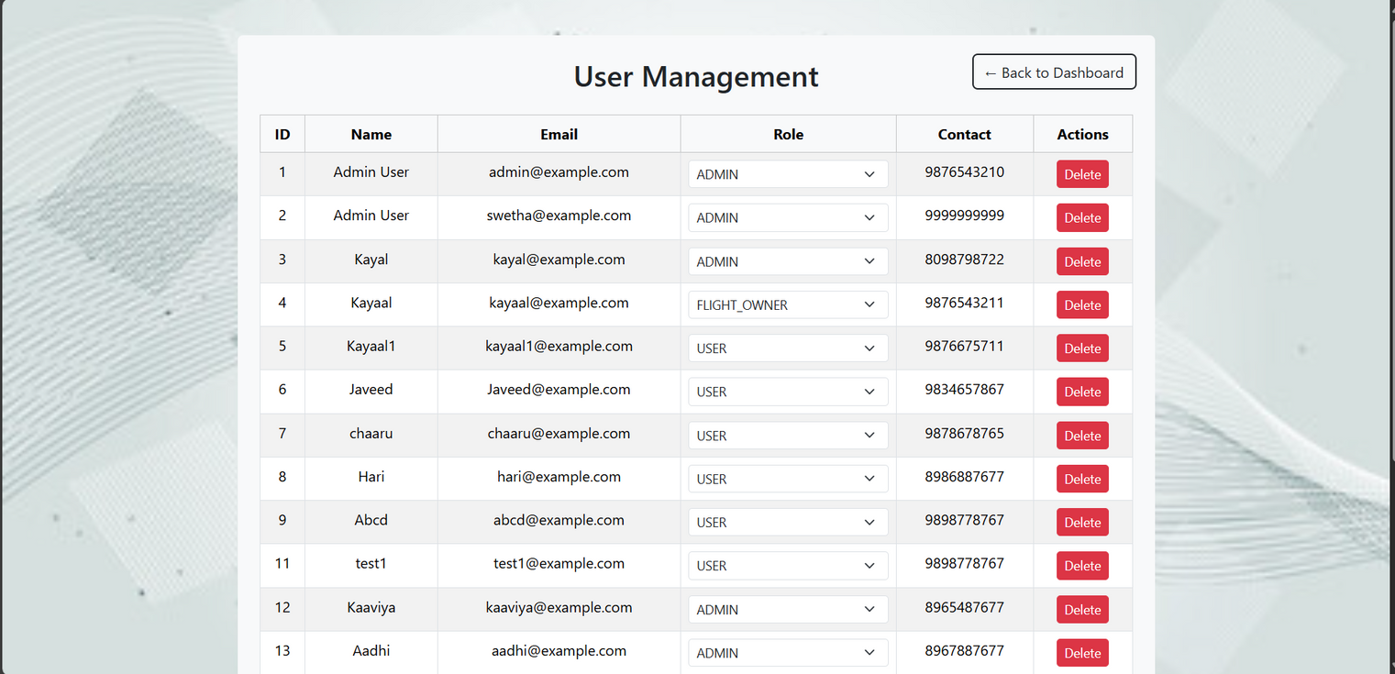
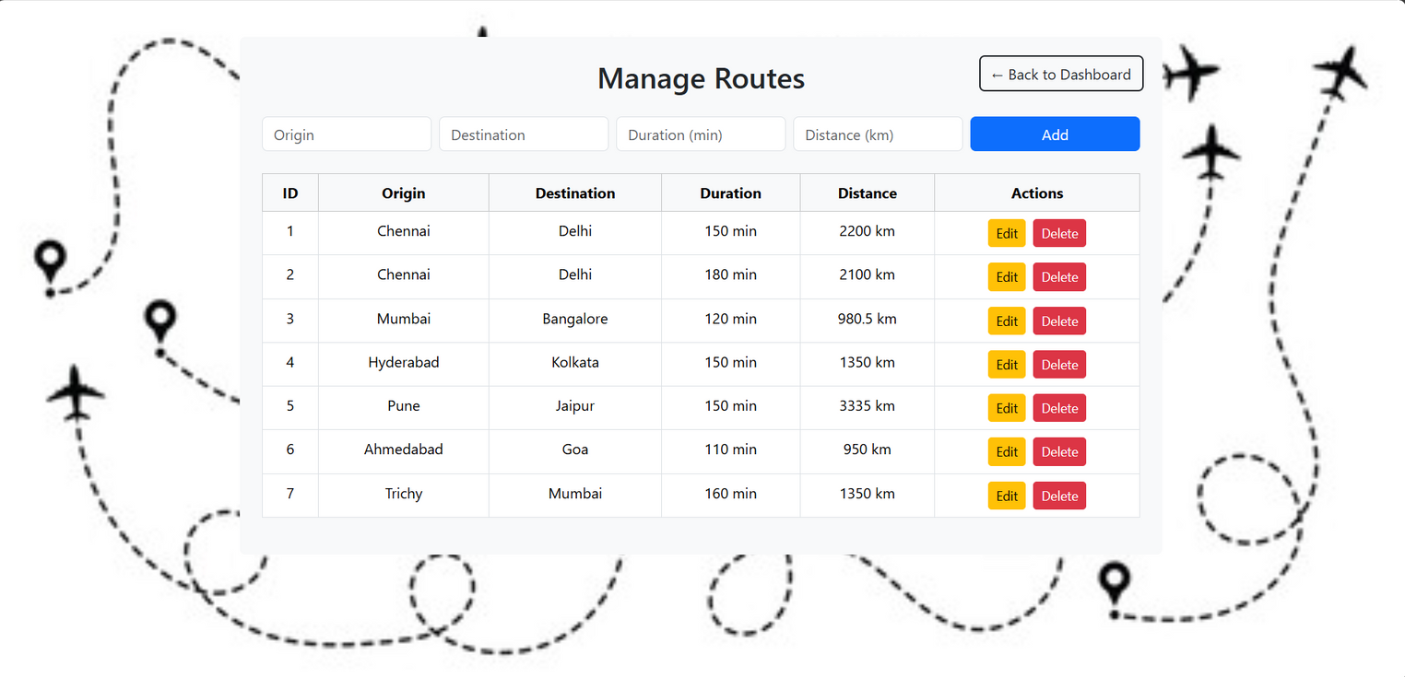
SCREENSHOTS

Slide 10
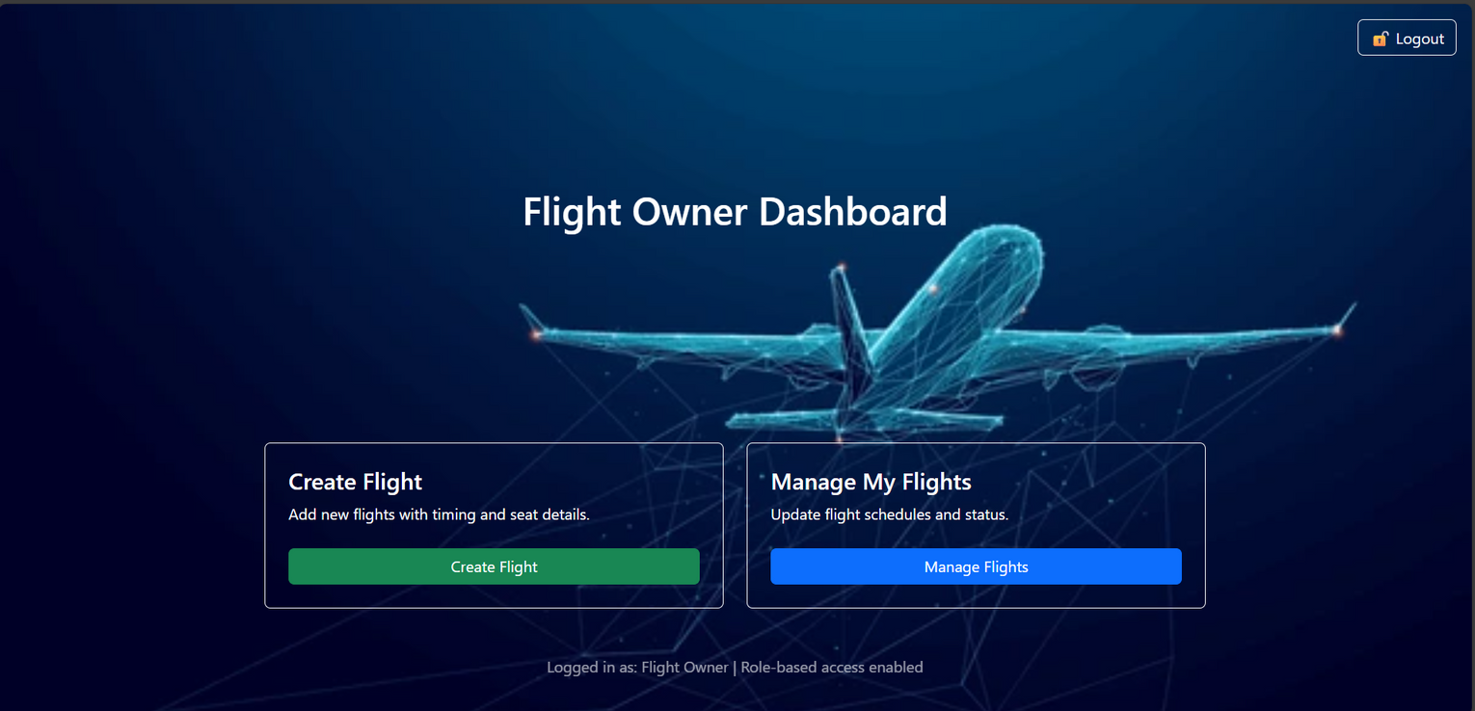
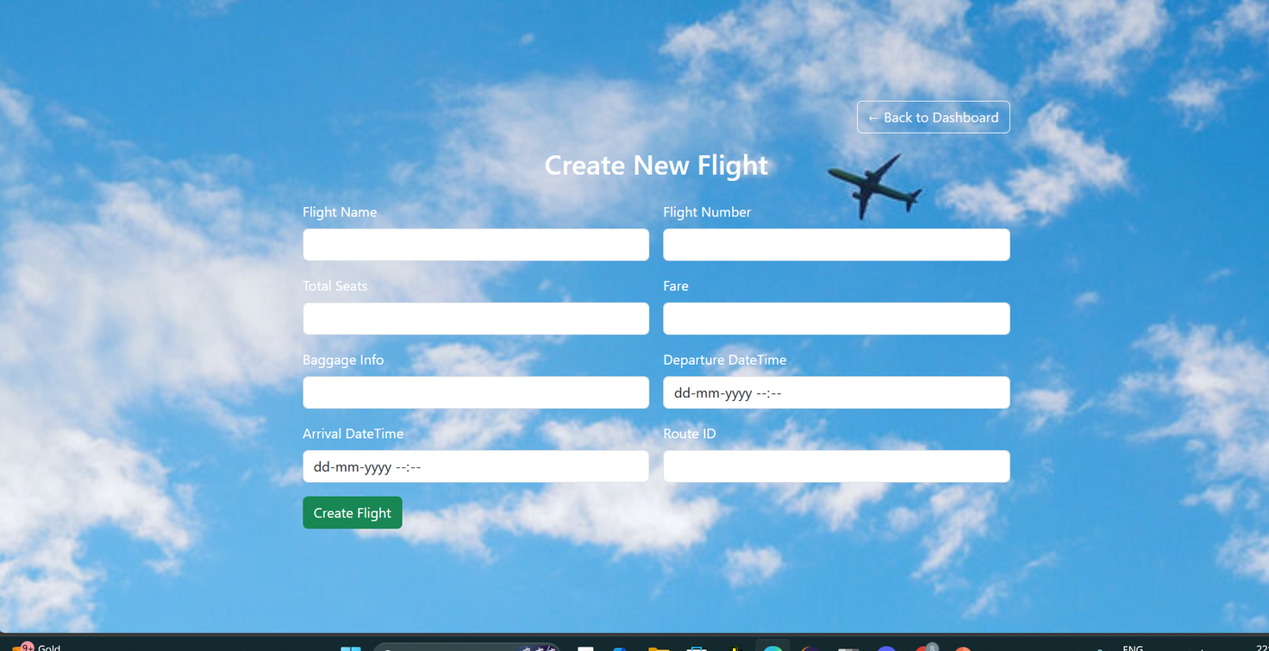
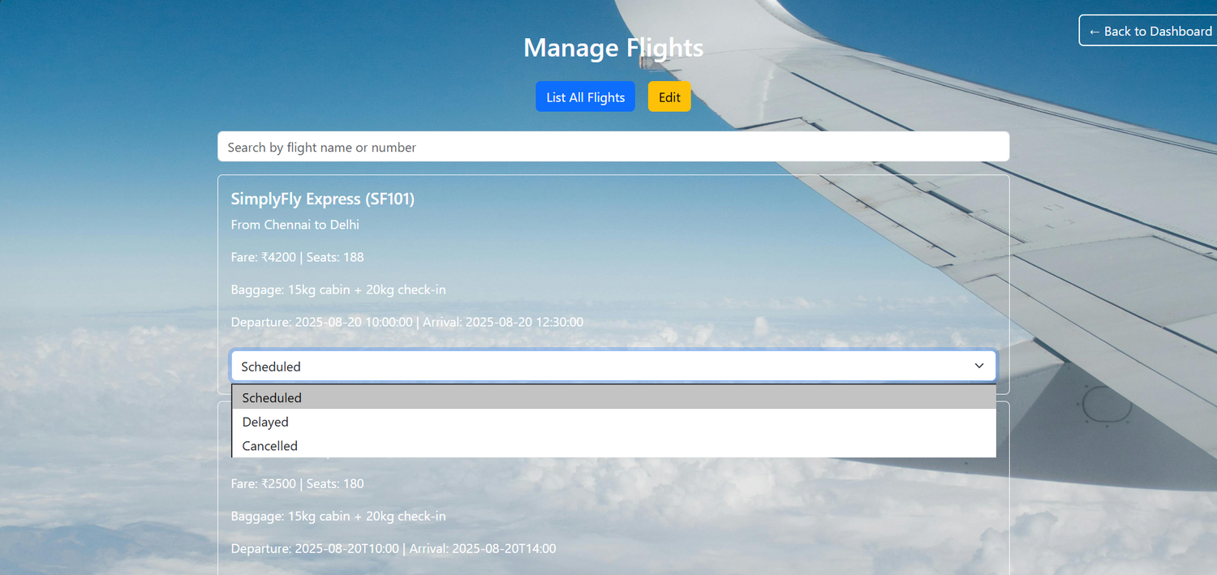
SCREENSHOTS
FLIGHT OWNER DASHBOARD

Slide 11
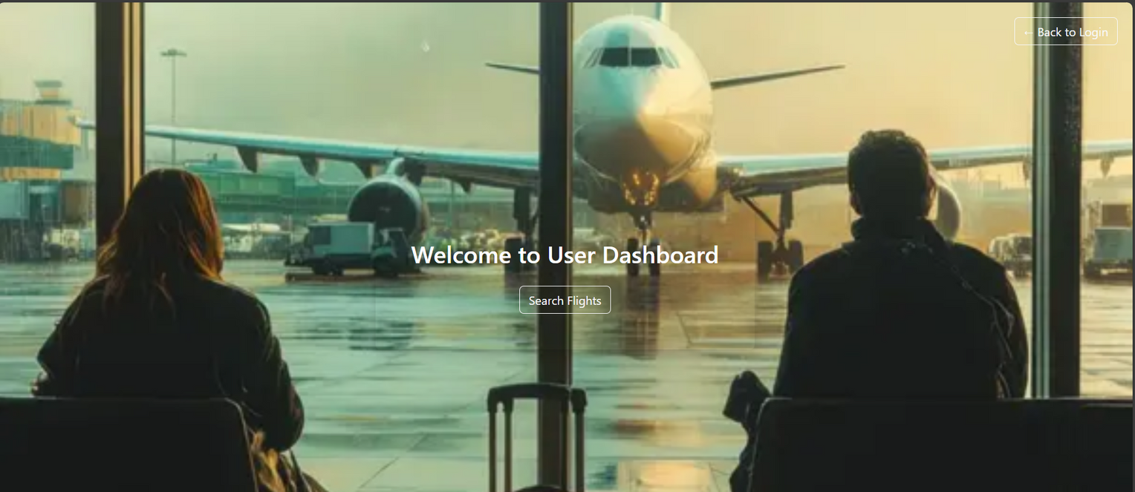
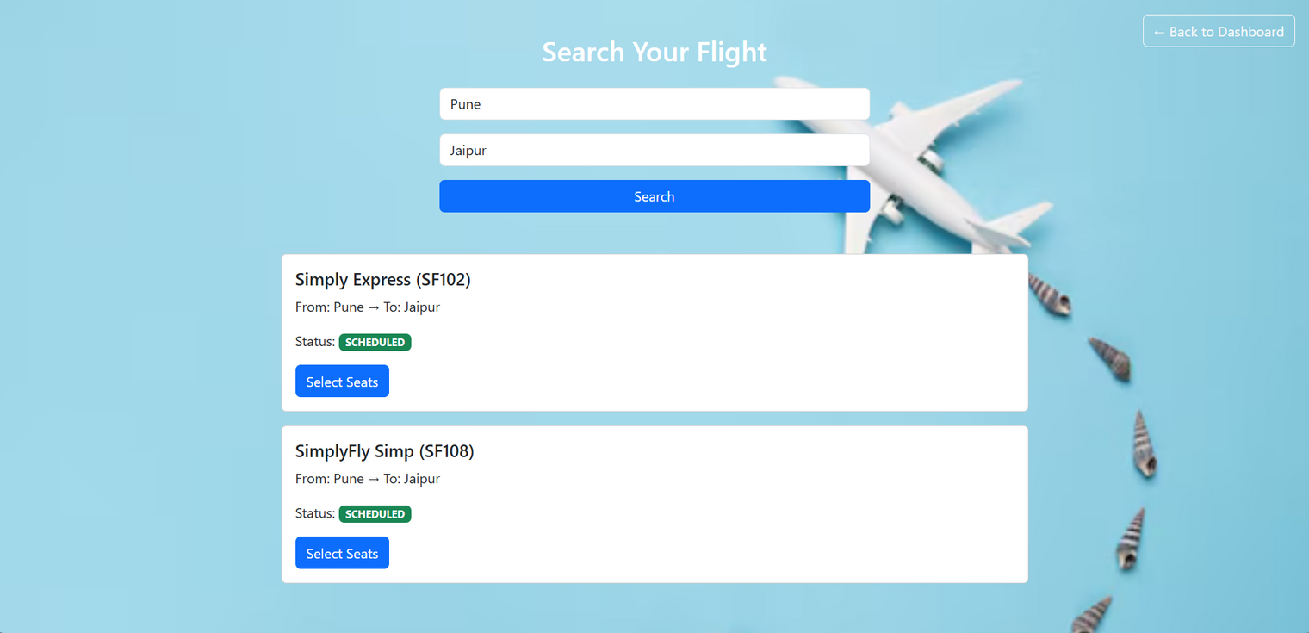
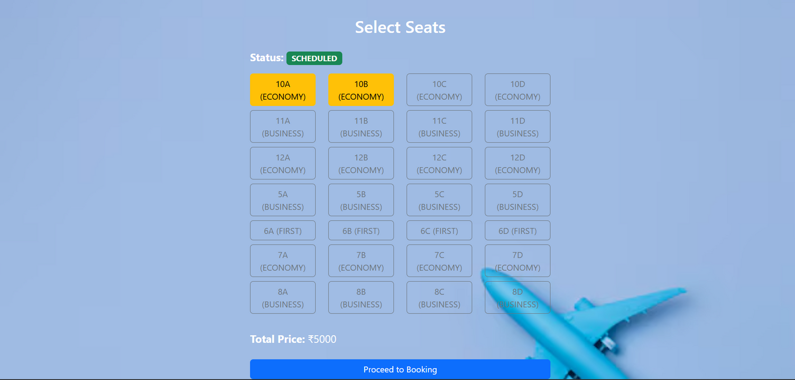
SCREENSHOTS
USER DASHBOARD

Slide 12
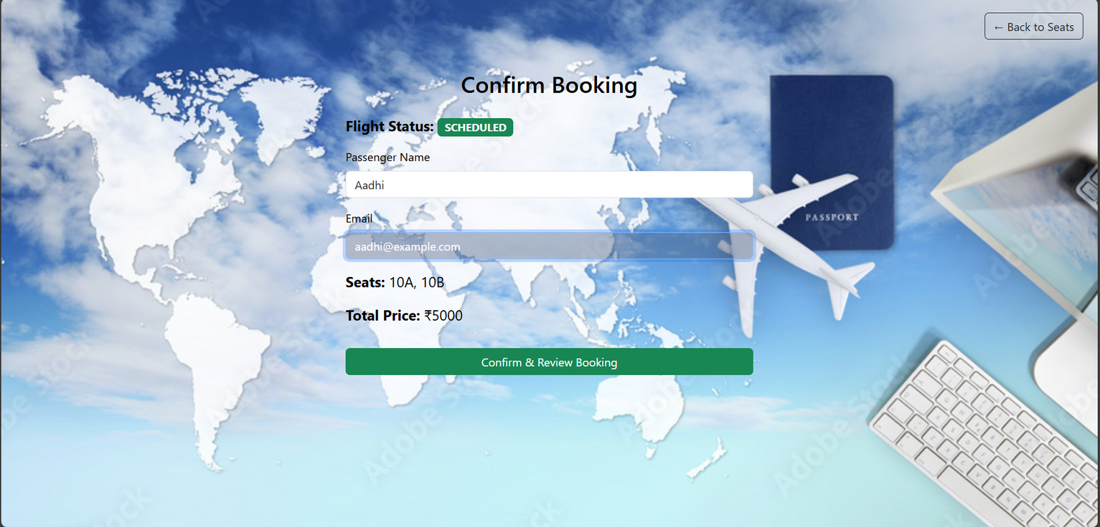
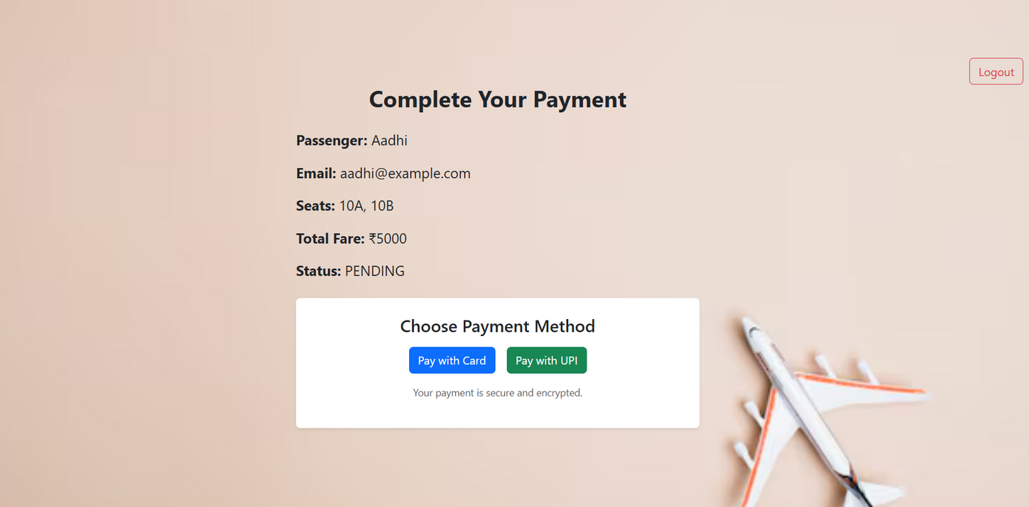
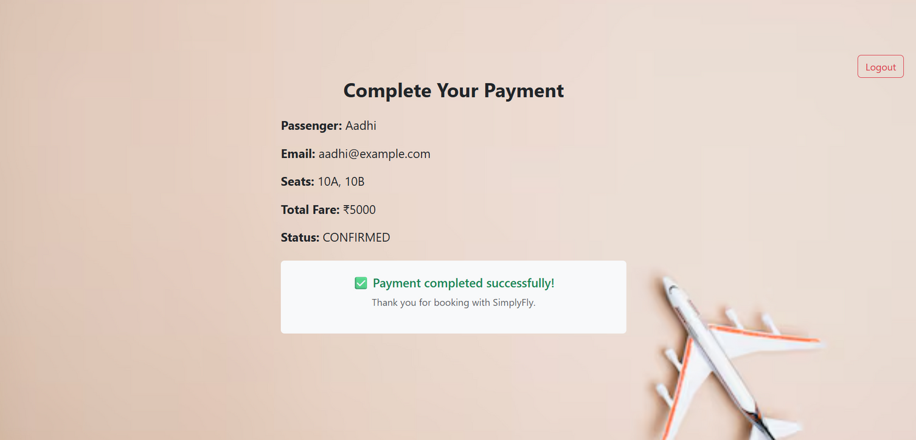
SCREENSHOTS

Slide 13
Thank
You

